Slide 1
Lab -10
Artificial Neural Network(ANN)
Machine Learning for Data Analysis DS-402

Slide 2
Download the dataset and
Run the commands for
Exploring and Processing the Data
Building and Training Your Neural Network
Visualizing Loss and Accuracy
Go through this Links for more details
https://www.freecodecamp.org/news/how-to-build-your-first-neural-network-to-predict-house-prices-with-keras-f8db83049159/
https://faroit.com/keras-docs/1.0.1/getting-started/sequential-model-guide/

Slide 3
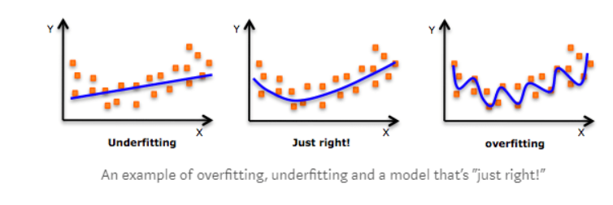
OVER FITTING AND UNDER-FITTING

Slide 4
How to check for Over fitting??
We often split our dataset into a training dataset and a validation dataset. As the name suggests, we train our model on the training dataset, and we validate the model’s ability to perform on unseen data in the validation set. The sign of overfitting is then a low training loss but a high validation loss, just like the over-fitting model we described in previous lecture (Model2).
Now if we know our model is overfitting, what can we do?
Here are a few strategies we can adopt, which we call regularization:

Slide 5
Data Augmentation
Weight Regularization
Drop-Out Technique

Slide 6
Strategy 1: L2 Regularization:
The penalty is the squared value of the parameters (scaled by some constant number), so the larger the parameters, the higher the loss will be.
Strategy 2: Dropout. During the training of our model, we randomly cause some of the neurons to be excluded from the neural network (i.e. drop out) at each step with a fixed probability. Since the model won’t know which neurons will be dropped out at each step, it is forced to not overly rely on key neurons, thereby preventing wild and crazy models.

Slide 7
Task
Do the same task with a new prediction problem and write the interpretation of the results.

